Slide 1



Data Access in .NET Core 3.0 Applications
Marco Minerva
Microsoft MVP Windows Development
Intel Software Innovator https://about.me/marcominerva
Riccardo Cappello
Microsoft MVP Microsoft Azure
Intel Software Innovator https://about.me/rcappello

Slide 3
.NET Core 3.0

Slide 4






.NET Core
3
2
.NET Core 3 expands supported workloads to include Windows Desktop, IoT & AI
.NET Core is perfectly suited for the requirements of cloud-native, cross-platform workloads
WEB
CLOUD
DESKTOP
IoT
AI
.NET CORE
.NET CORE 3
LIBRARIES
INFRASTRUCTURE
RUNTIME COMPONENTS
COMPILERS
LANGUAGES
Notes:
https://blogs.msdn.microsoft.com/dotnet/2018/05/07/net-core-3-and-support-for-windows-desktop-applications/
As developers, we want to ensure our code PERFORMS WELL, is PORTABLE, and is MAINTABLE.
With .NET Core 3 we are bringing support to new device types including AI, IOT, and DESKTOP.
.NET CORE for DESKTOP means you NO LONGER need a DEPENDENCY on the .NET FRAMEWORK installed on the machine – you ship what you need.
.NET CORE has a smaller footprint and IMPROVED PERFORMANCE. .NET CORE also supports a more MODERN .csproj PROJECT SYSTEM.

Slide 5

.NET Core 3.0 Desktop improvements
Supports for WPF and Windows Forms frameworks
XAML Islands: Windows Forms & WPF can host UWP
XAML Controls: Windows Forms & WPF browser and media UWP controls
Improvements on HDPI support
Access to all the Windows 10 API’s
.NET Core App Bundler
Precompiled, fast startup
Small apps by removing unused dependencies, link away unused IL
Single self-contained .EXE
Notes:
You will get to MAXIMIZE CODE RE-USE across all of these DEVICE TYPES and we will SUPPORT WINFORMS and WPF controls and XAML ISLANDS.
You will have access to ALL WINDOWS 10 APIS and .NET CORE TOOLING that will bring you that IMPROVED PERFORMANCE.

Slide 6
Why Windows Desktop on .NET Core?
Side by side execution
Machine global or app local framework
Core runtime and API improvements
New .csproj project system
Notes:
http://danpatrascu.com/whats-the-point-of-net-core-3-0-desktop-applications
Having desktop applications in .Net Core means that developers can take advantage of the self contained deployment of .Net Core applications so on one computer we can potentially have several such desktop applications, each running on different versions of .Net Core.
From a more strategic point of view, bringing desktop applications to .Net Core 3.0 means that Microsoft continues to open source parts of their proprietary Windows centric products and APIs. This is a clear message that when Microsoft talks about the benefits of open source software, they really mean it since they bring more and more products and APIs to the open source world

Slide 7
The future of .NET Framework
.NET Framework 4.8 is a 18 years old Framework
Innovating without breaking anything is nearly impossible
It won’t support .NET Standard 2.1
.NET Framework will be supported for years ☺, but we don’t know if there will be another one after 4.8
New applications should be started in .NET Core
https://marketplace.visualstudio.com/items?itemName=BrianLagunas.ConvertProjectToNETCore3
Extension to convert WPF applications to .NET Core 3.0
Notes:
https://medium.com/@andy.watt83/the-net-framework-is-done-8aec3bbae12d

Slide 8
.NET Portability Analyzer
Analyze a .NET Framework project to check whether it is compatible with the various .NET platforms
Available as Visual Studio Extensions and command line tool
Gets a report with compatibility problems and suggestions to solve the issues
https://docs.microsoft.com/en-us/dotnet/standard/analyzers/portability-analyzer

Slide 9
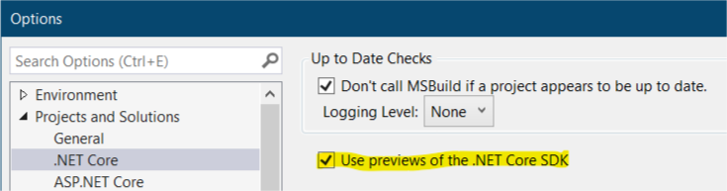
Start experimenting with .NET Core 3.0
Install Visual Studio 2019 Preview
Download the latest 3.0.x bits from https://dotnet.microsoft.com/download/dotnet-core/3.0
Create a WPF or Windows Forms application via the New Project dialog or from CLI
dotnet new wpf –n <app_name>
dotnet new winforms –n <app_name>
No Designer support (yet)
Be sure to enable the
Preview .NET Core SDK

Slide 10
Demo

Slide 11
Data Access Methodologies

Slide 12
System.Data.SqlClient
Fully supported in .NET Standard 2.0
Safe to use with .NET Core 3.0
Includes the loved and hated DataSet

Slide 13
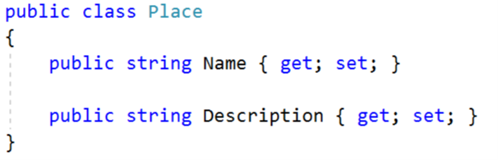
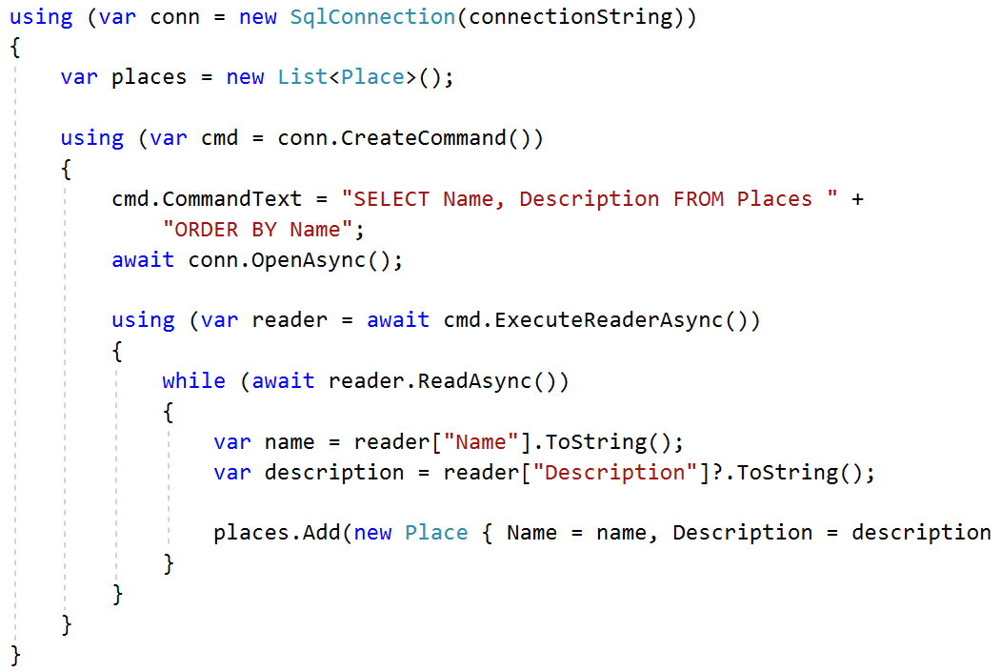
Classic ADO.NET approach

Slide 14
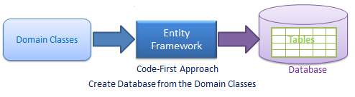
Entity Framework Core
OR/M
Re-written from scratch
Lightweight, extensible, cross-platform
Better performance than Entity Framework
Supports only a subset of Entity Framework features

Slide 15
Only in EF6
Only in EF Core
Entity splitting
Batching of statements
Mixed query evaluation
Shadow properties
More readable SQL
Client key generation
Field mapping
Rich value conversions
DbContext pooling
Simple function mapping
Alternate keys
Disconnected graph API
Query types (no keys)
Change tracking proxies
Stored procedure mapping for CUD
Visual designer
TPT, TPC inheritance
Simple logging API
Database-agnostic SQL dialect
Interception extensibility
DI and service replacement
LINQ composition over raw SQL
Non-default constructors
In-memory provider (for testing)
Global query filters
Common features
Seed data
Lazy loading
Connection resiliency
TPH inheritance
Compiled queries
GroupBy translation
Any type from raw SQL
Eager loading for derived types
Cross-platform & .NET Standard
System.Transactions
Change tracking events
Complex/owned types
Table splitting
Eager loading
Rich diagnostics and logging
Many-to-many
Spatial data*
Cosmos DB provider*
Collections of owned entities*
Query tags*
Reverse engineering of database views*
* New in EF Core 2.2

Slide 16
Entity Framework * roadmap
2018
2019
Entity Framework Core 2.2
Cosmos DB provider (preview)
Spatial extensions for SQL Server and SQLite
Reverse engineering of database views
Collection of owned entities
Query tags
Entity Framework Core 3.0
Improved LINQ implementation
Aggregate behaviors
C# 8 support:
Nullable reference types
Standard IAsyncEnumerable<T> interface
Public code first conventions
Better support for Views
Property bag entities (for many-to-many relationships)
Ignore parts of the model for Migrations
Entity Framework 6.3 running on .NET Core 3.0
Notes:
https://docs.microsoft.com/en-us/ef/core/what-is-new/roadmap
https://www.infoq.com/news/2019/01/EF-Core-3.0-Roadmap
Features not on the EF Core 3.0 Roadmap
Stored Procedures
First class support for stored procedures will not be offered in the EF Core 3.0 timeframe.
Table Per Type Inheritance
When tables are very wide with far too many columns, one technique to address the problem is Table Per Type inheritance. With this model, each row is identified as belonging to one of several subtypes. Each subtype gets its own table with just the columns that are unique to that subtype. Only columns that are common to all subtypes remain in the original table.
Currently table per type inheritance is supported by Entity Framework, but not EF Core.
Upsert
Upsert, the ability to conditionally insert or update a record, is considered a second-tier ORM feature. While not necessary, it is nice to have as it can reduce round-trips to the database and simplify code. However, it currently doesn’t fit the EF Core model.

Slide 17
Entity Framework 6.3 on .NET Core 3.0
Cheapest way to move existing app to .NET Core
EF Core 3.0 will still be recommended
No new features in EF6 (but PRs are considered)
Cross-platform (Windows, Linux, Mac)
No spatial support for SQL Server
Providers will need to port too
EF Designer may require workarounds

Slide 18

Dapper
Micro OR/M
Speed
Simplicity
Avoiding the ceremony of ADO.NET
We don’t have many features of Entity Framework
Lazy Loading
Change Tracking
…
Notes:
https://iamtimcorey.com/ask-tim-dont-use-entity-framework/
https://medium.com/@engr.mmohsin/entity-framework-core-2-dapper-performance-benchmark-c29e8cce9e1b
Speed – OR/M means overhead, a micro OR/M performance will be very close to plain ADO.NET. In my experience, data access is very often the performance bottleneck.
OR/Ms ship with a bunch of features that require some extra work that you don’t need, shouldn’t need. OR/Ms often need a significant amount of configuration and setup, especially if you don’t (or can’t) follow conventions. With a Micro OR/M it’s pretty much Install-Package and you’re ready to go.
ADO.NET is (was) pretty great, but it shipped with .NET 1.0, that’s like 18 years ago
In technology terms, it’s as old as the moon. There is so much ceremony with ADO.NET that it’s just intolerable in many (not all) cases

Slide 19
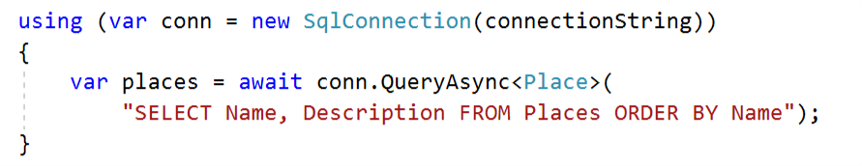
How it works
Sits right on top of ADO.NET
Extension methods for IDbConnection
We need to write SQL
Updating legacy applications is much easier

Slide 20
Data Access Architecture

Slide 21



N-tier architecture
Presentation Layer
Business Layer
SqlClient
Entity Framework
Dapper
…
Data Access Layer
Notes:
https://it.wikipedia.org/wiki/Architettura_multi-tier

Slide 22
Classic (old) approach
Presentation Layer
Business Layer
On the client
Data Access Layer

Slide 23

Client/server approach
Presentation Layer
On the client
Network
Business Layer
Exposed as a service
Data Access Layer

Slide 24
Demo

Slide 25
References
https://dotnet.microsoft.com
https://github.com/dotnet/wpf
https://github.com/dotnet/winforms
https://docs.microsoft.com/en-us/ef/core
https://github.com/StackExchange/Dapper
https://www.telerik.com/products/wpf/overview.aspx
https://github.com/marcominerva/SqlSat829

Slide 26
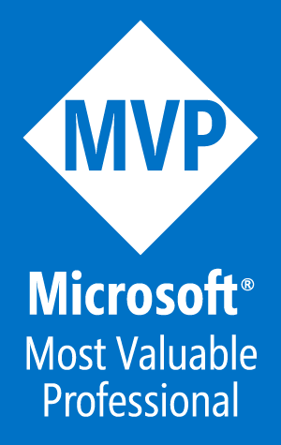
Thanks! Questions?
Marco Minerva - @marcominerva
Microsoft MVP – Windows Development
http://about.me/marcominerva
Riccardo Cappello - @rcappello
Microsoft MVP – Microsoft Azure
http://about.me/rcappello
DotNetToscana
Dotnettoscana.org
@dotnettoscana

